Slide 1
Stress of teachers
By
Y. CHETAN SAI,
March batch 2022,
Teachnook.

Slide 2
introduction
Stress is usually experienced by all men and women when there any challenges a head.
The teaching is one of complex and stressful form of social service where teachers will take various responsibilities and complete the work by accepting the challenges.
Basically teachers high stress levels are aggressive behavior, frustrating, absence of work etc.

Slide 3
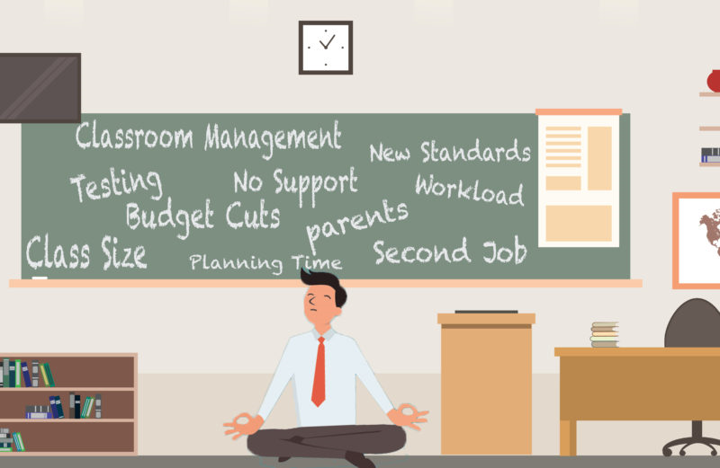
Generally I felt that teachers are the one of the employees who faces the more stressful conditions.
Example: coping with the time table, syllabus condition, make the student understand the subject etc.
So, I choose teachers for to take the survey on.

Slide 4
Literature review
Stoeber & Rennert (2008): Teacher stress is high, in fact teachers exhibit higher levels of stress than any other profession..
McCallum & Price (2010): The one thing we do know is that in order for teachers to teach wellbeing to students, they themselves must be well.
Curry & O'Brien (2012): Whether this be day to day stress of required tasks or institutional stress factors, teachers are struggling.
Roffey (2012): Wellbeing in schools is typically centered on meeting student needs yet with the extensive data on the incidence of teacher stress, it seems only reasonable that teacher wellbeing should be addressed as well.

Slide 5
Methodology
In methods among qualitative and quantitative, I would like to prefer quantitative.
Type of study: It is done on the basis of google form where the questionnaire is used to take on the survey.
Type of questionnaire: Basically there are two types of questionnaire they are open-ended and closed-ended. I choose closed ended type where the faculties are asked to respond to the questions only through marking the available options.

Slide 6
All questions are in the form of multiple choice questions.
The options given are,
a) Strongly disagree
b) Disagree
c) Neutral
d) Agree
e) Strongly agree

Slide 7
I have made 9 questions. they are:
Don't have time to spend on personal hobbies.
Unable to handle certain situation due to stress.
Stress results less sleep.
Unable to spend time with family.
It affects me mentally.
It is better to take practical guidance.
In male stress results baldness.
Feeling difficulty to cope up with syllabus before the time limit.
It results illness.

Slide 8
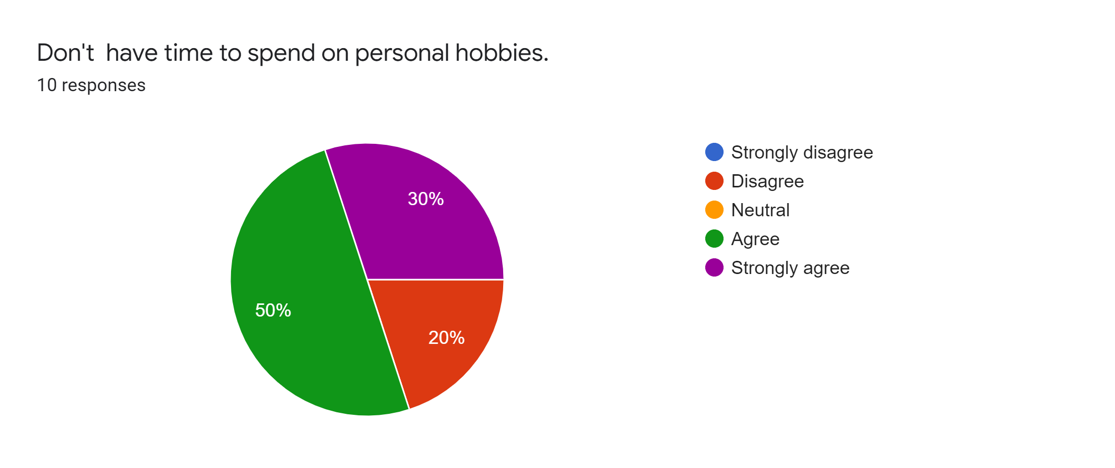
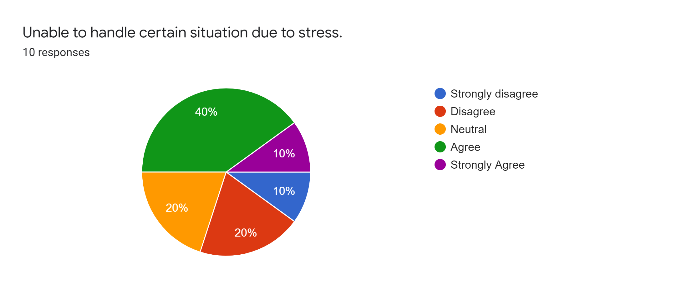
result

Slide 9
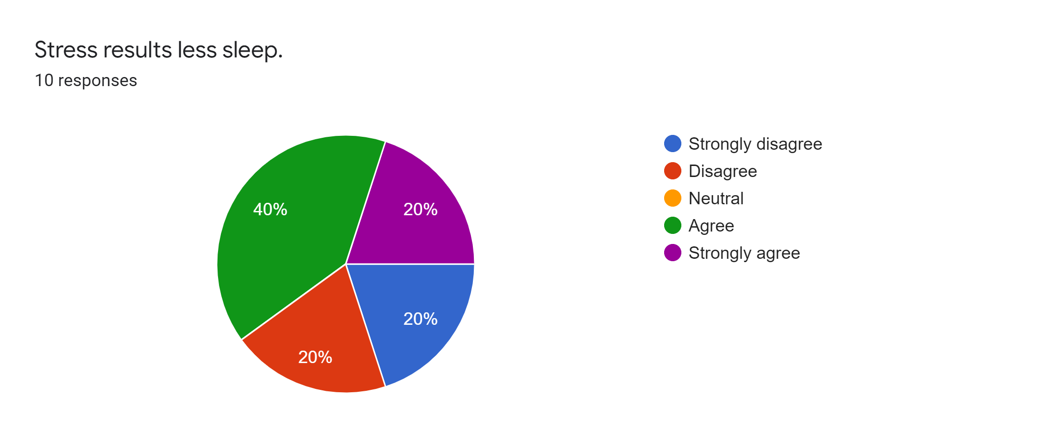
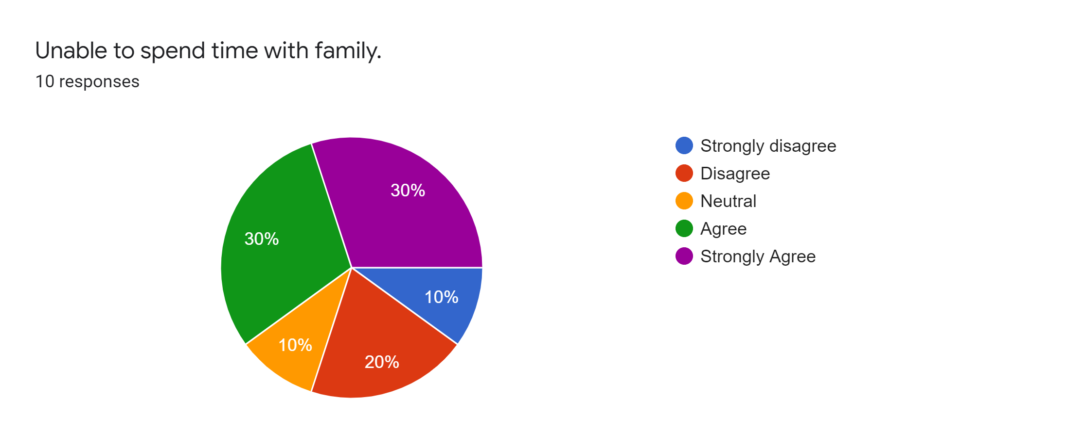

Slide 10
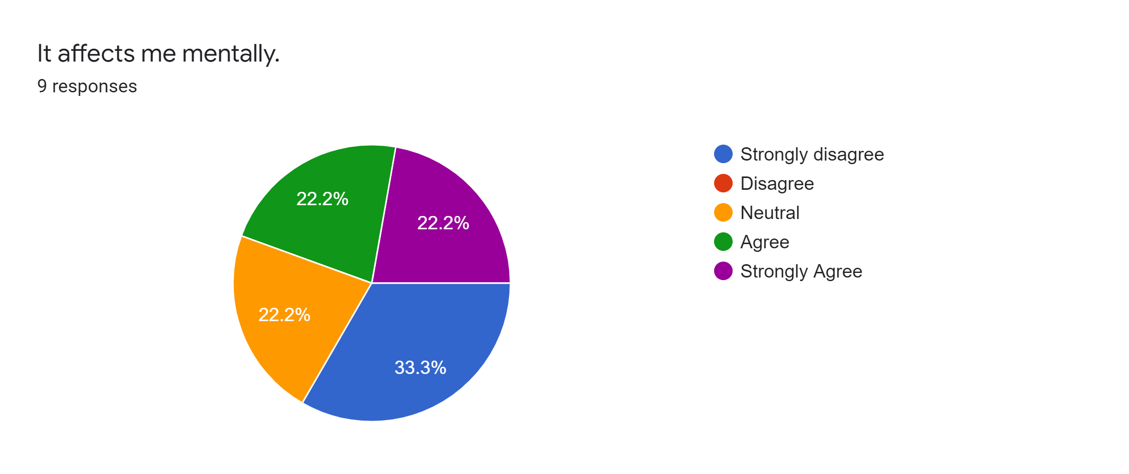
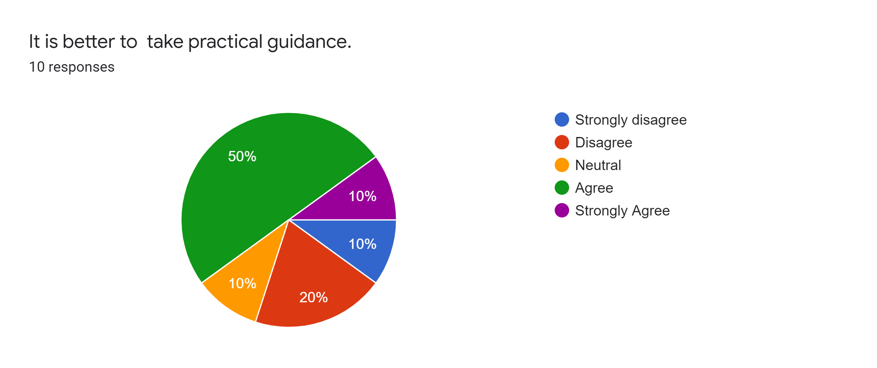

Slide 11
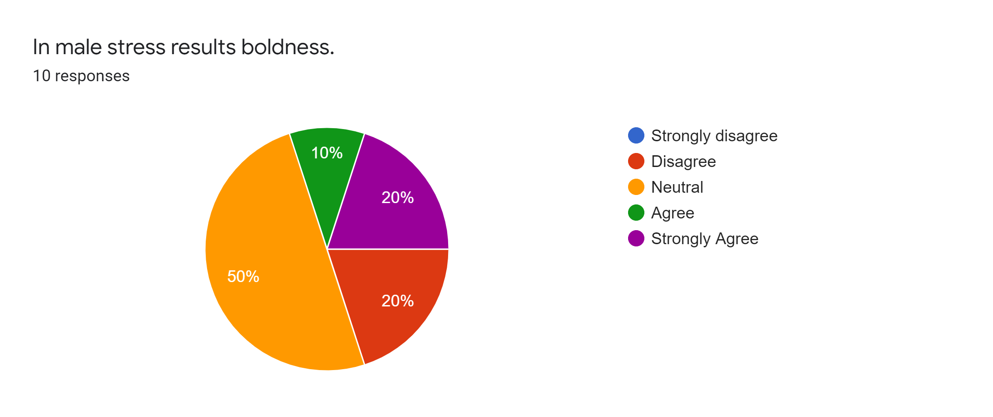
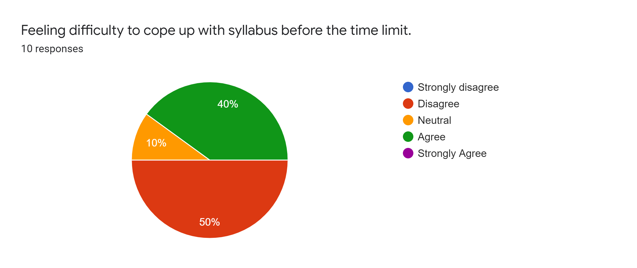

Slide 12
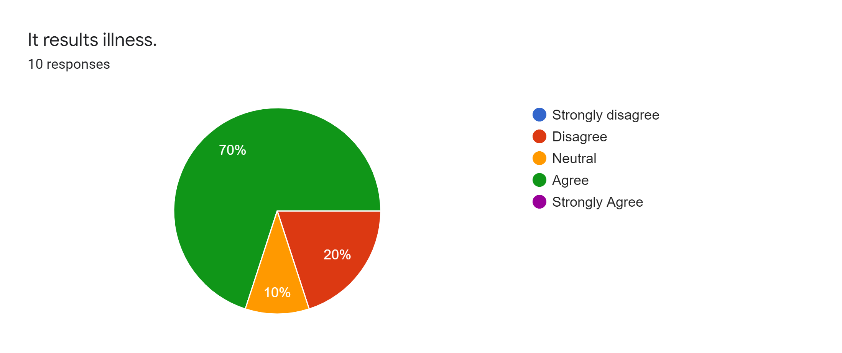

Slide 13
conclusion
Currently many changes are happening in the education system and of course, any changes will put pressure on the teachers.
As the technology is changing we can also accommodate many things to decrease the stress in the teachers.
Finally this research is about how the stress affects the teachers mentaly and physically.

Slide 14
Thank you

